Slide 1
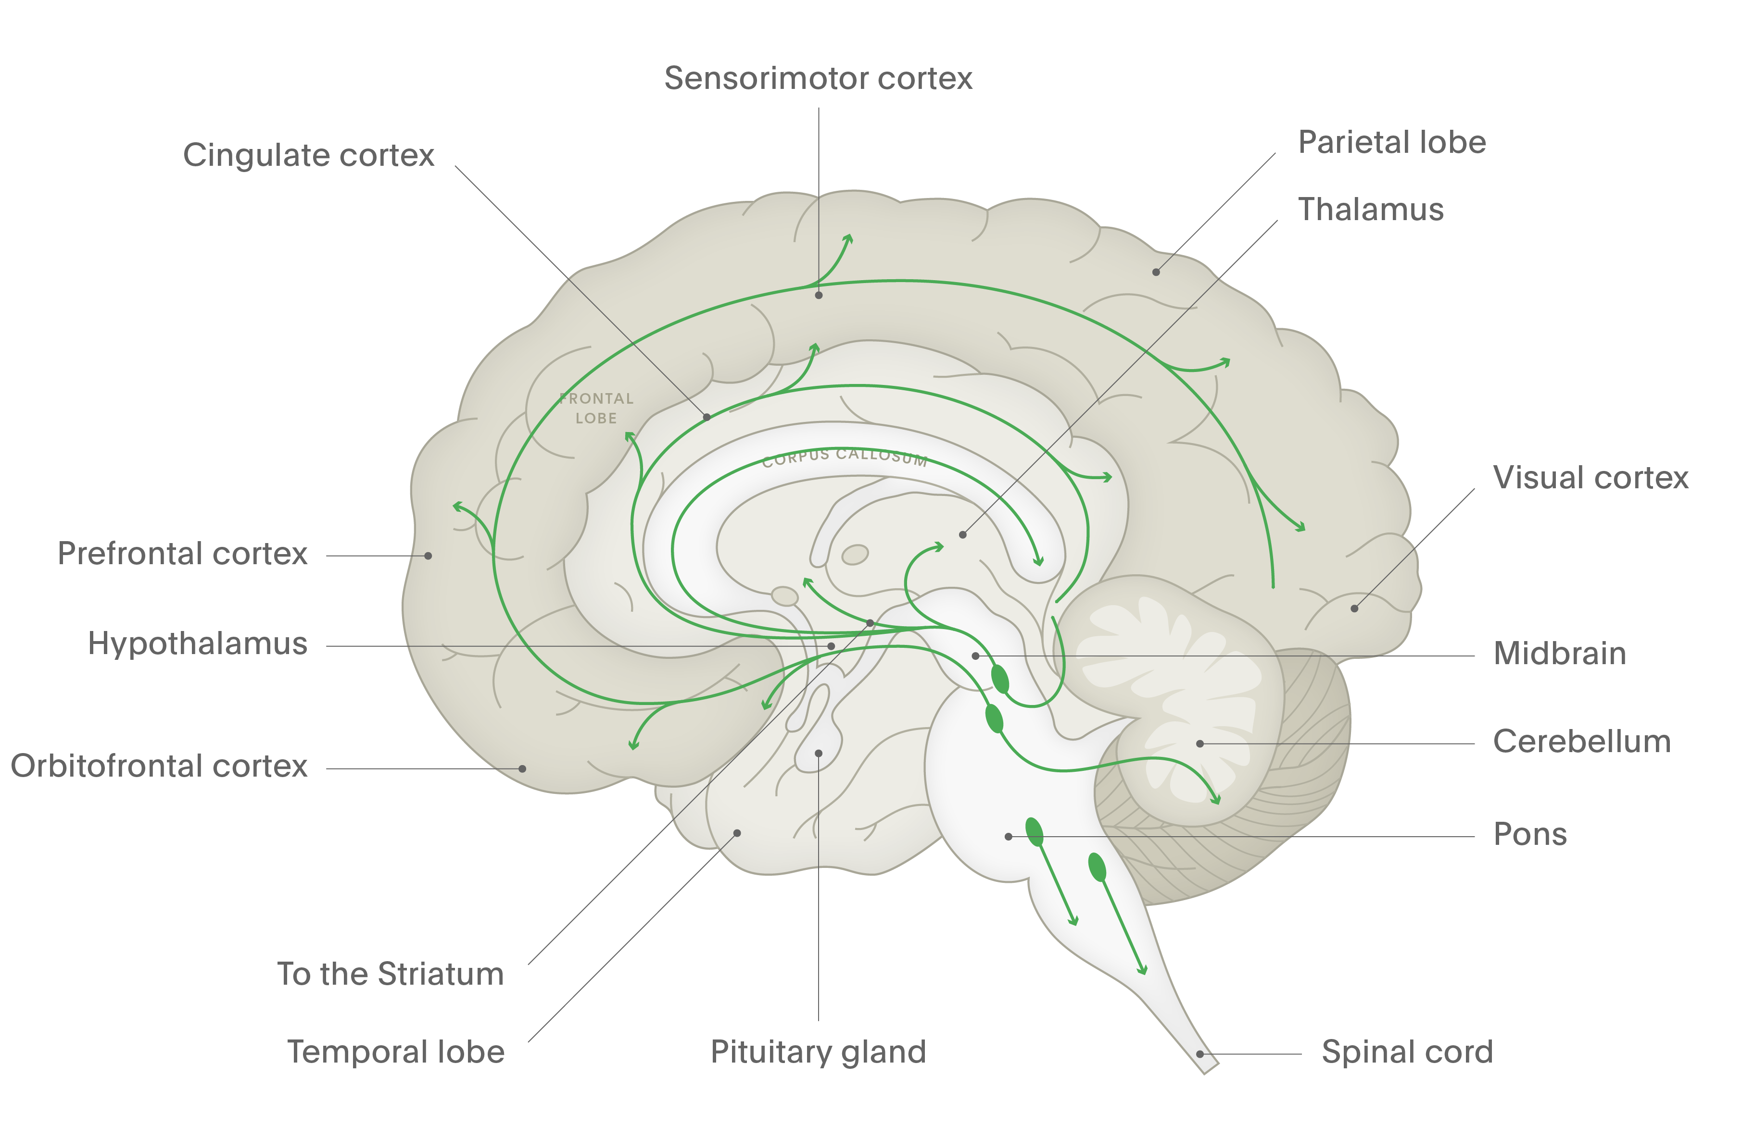
Serotonin
NH₂
HO
Mental Health
N
H
Serotonin (also known as 5-HT) is a neurotransmitter that is found throughout the body.¹ High concentrations are found in the CNS, platelets, and certain cells in the gastrointestinal tract¹
There are many receptor subtypes for serotonin; the roles of these receptor subtypes are not fully elucidated
Serotonergic neurones project widely throughout the brain from their origin in the raphe nuclei of the brainstem^{2,3}
Cerebral cortex
Within the forebrain, serotonin is thought to regulate sleep and wakefulness²
Raphe nuclei
Spinal cord
Serotonergic projections to the spinal cord may regulate pain³
CNS = central nervous system
1. Brunton et al. Goodman & Gilman’s the Pharmacological Basis of Therapeutics. 11th edition. 2006;
2. Purves et al. Neuroscience. 4th edition. 2008;
3. Stahl. Stahl’s Essential Psychopharmacology. Neuroscientific Basis and Practical Applications. 4th edition. 2013
Notes:
Serotonin (also known as 5-HT) is a neurotransmitter that is found throughout the body.[Brunton et al., 2006; Stahl, 2013; Purves et al., 2008] The wide dispersal of serotonergic neurones throughout the brain enables serotonin to be involved in modulating diverse body functions. Body functions modulated by serotonin include:^{[Brunton et al., 2006]}
mood
sleep
cognition
sensory perception
pain perception
movement
regulation of internal temperature
appetite
sexual behaviour
hormone secretion.
References:
Brunton LL, Lazo JS, Parker KL (eds). Goodman & Gilman’s the Pharmacological Basis of Therapeutics. 11th edition. McGraw-Hill, 2006.
Purves D, Augustine GJ, Fitzpatrick D, et al. (eds). Neuroscience. 4th edition. Sinauer Associates, 2008.
Stahl SM. Stahl’s Essential Psychopharmacology. Neuroscientific Basis and Practical Applications. 4th edition. © Cambridge University Press, 2013.

